Slide 1
PyFIT
Demo
Understand your body
PyF
Final Project
Suraj Nagaraja
RUID: 189005203

Slide 2
Contents
Pyfit
Introduction
Features
The Dataset
Code- Library
Code- Main Program
Readme - Running the Program
Running the Program
Outro

Slide 3
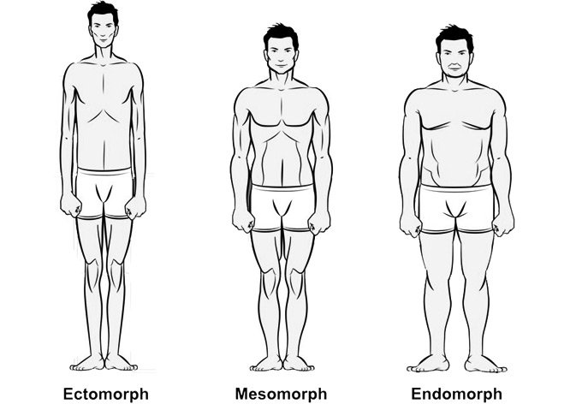
Understanding the different body types
PyFIT
THE 3 MALE BODY TYPES
Ectomorph
Mesomorph
Endomorph
Narrow hips and shoulders
Small joints
Long and thin build
Stringy muscle bellies
Wider shoulders
Narrow waist
Thin joints
Long and Round muscle bellies
Blocky with thick rib cage
Hips wider than shoulders
Thick joints
Shorter limbs

Slide 4
How does Pyfit work?
PYFIT
PYFIT uses a machine learning algorithm to determine body type based on your body measurements.
The system’s classification algorithm is trained using a dataset with multiple body measurements along with the corresponding body type.
Once PYFIT has learned the range of body measurements and corresponding body type, it accurately classifies the users body into one of the three categories upon entry of body measurements.

Slide 5
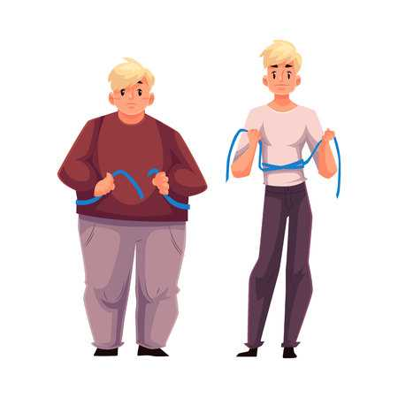
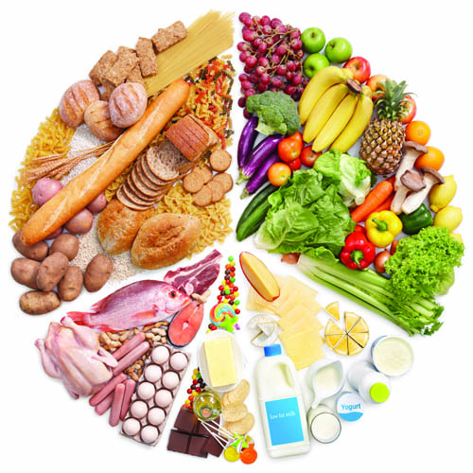
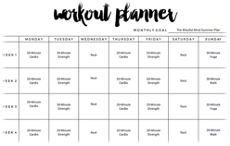
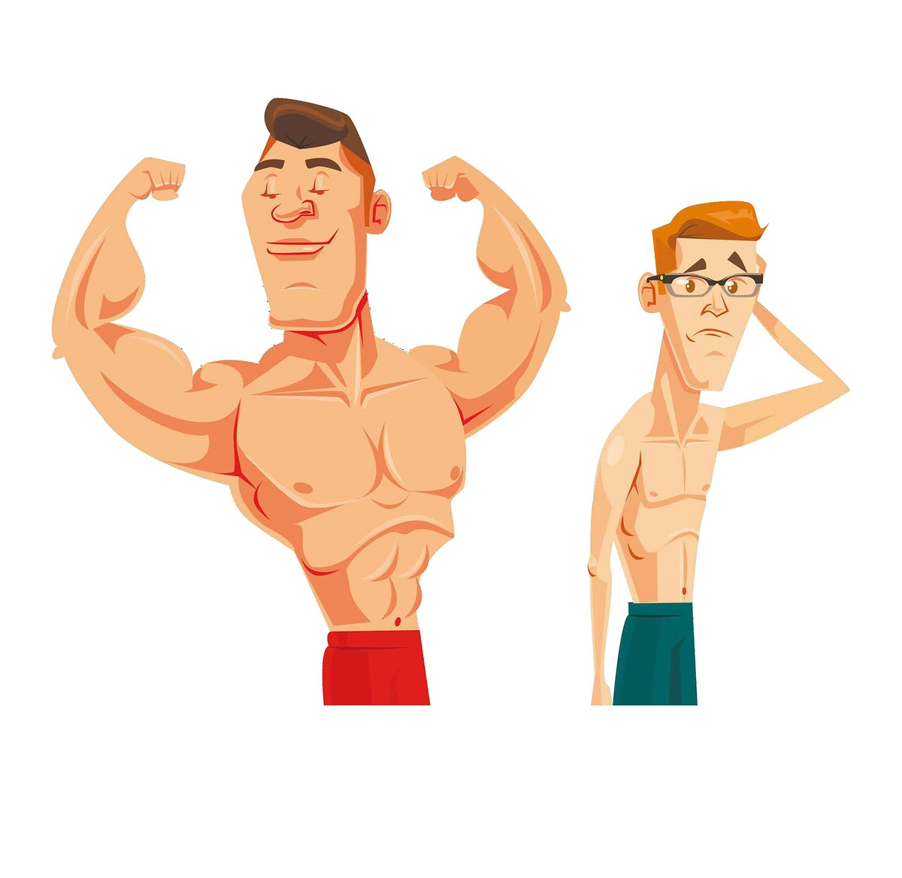
PYFIT
Based on your body type, it recommends suitable nutrition and workout plans.
Just stick to your nutrition and workout plans to discover a new you!
PYFIT
Nutrition Plan
PYFIT
Workout Plan
You

Slide 6
FEATURES
PYFIT
Determines body somatotype based on user’s body dimensions.
Provides summary and detailed diet and workout reports based on the determined somatotype.
Progress tracking feature which allows the user to track his progress since the first time he used the system.
The progress tracker displays a table with the user’s past information along with a graph displaying the change in weight and body fat percentage with time.

Slide 7
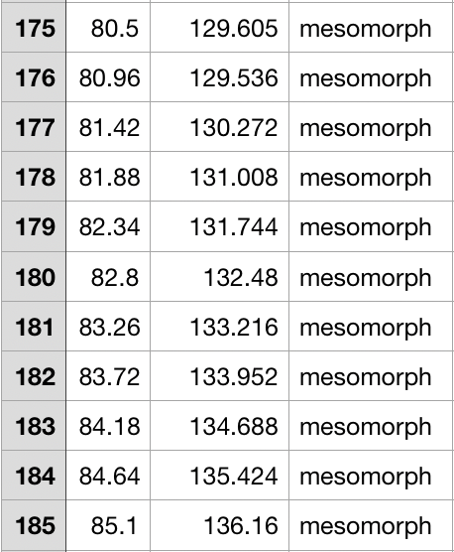
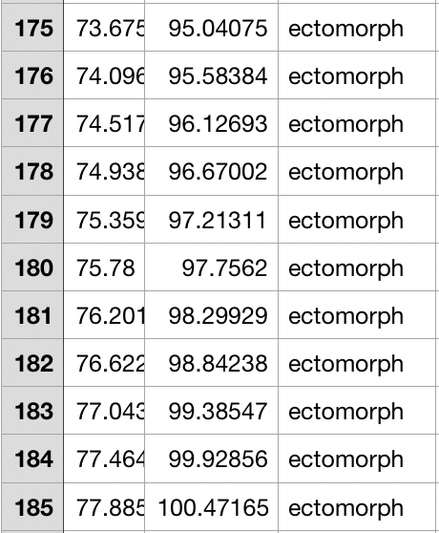
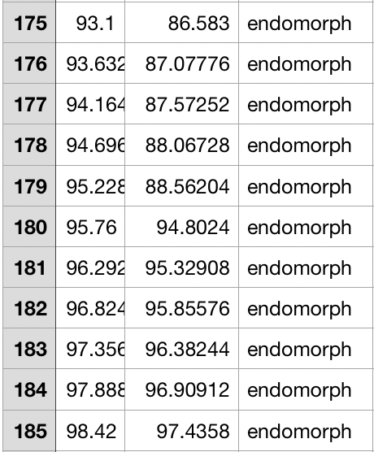
The dataset
PYFIT
The images to the right are screenshots of the CSV file containing the dataset for our application.
It contains 10,140 entries and is divided into the following columns- height(cm), waist(cm), shoulder(cm) and body-type.
The dataset was created after a thorough research about the 3 body types and their corresponding measurements.
According to experts, the ideal body type has to meet the following requirements:
Waist circumference = 45-47% of height
Shoulders = 1.618 times the waist

Slide 8
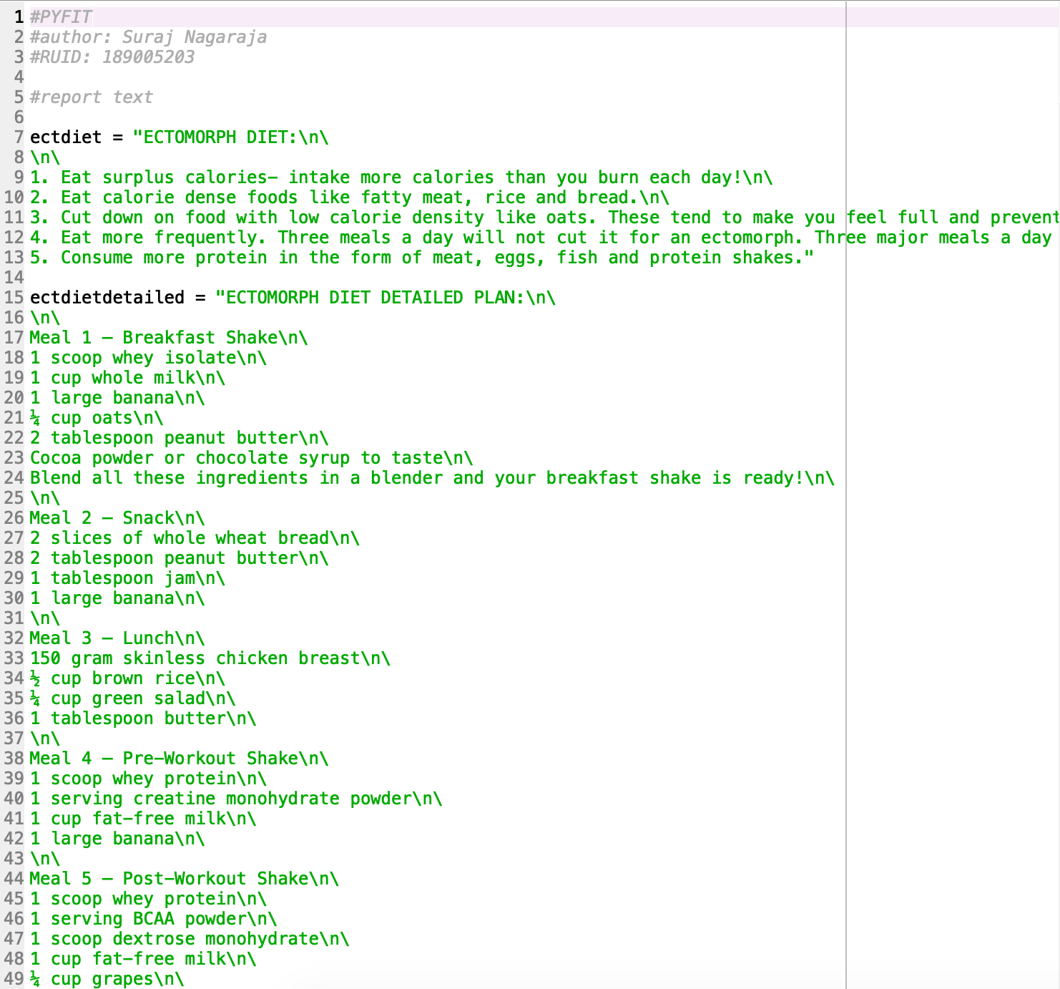
CODE- the library
PYFIT
Before looking at the main program, let's have a look at the library.
This is a screenshot of the PYFIT library.
It contains predefined, customized meal and workout plans for all 3 body types stored in variables.
*This screenshot only shows the detailed and summary diet plans for ectomorphs. It is stored similarly for the other cases.

Slide 9
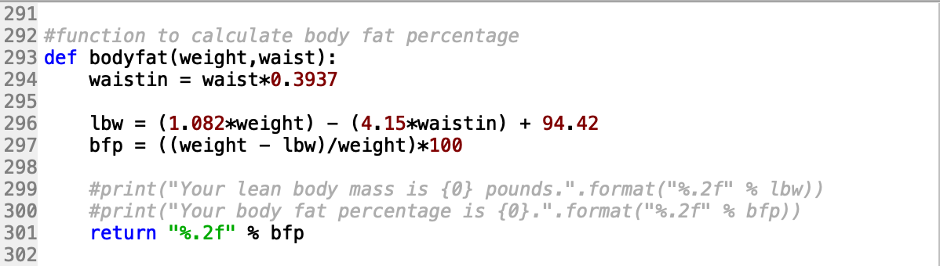
CODE- the library
PYFIT
The next item in our library is a function that calculates the lean body weight and body fat percentage using the waist and weight inputs from the user.
This function returns the body fat percentage rounded off to two decimal places.

Slide 10
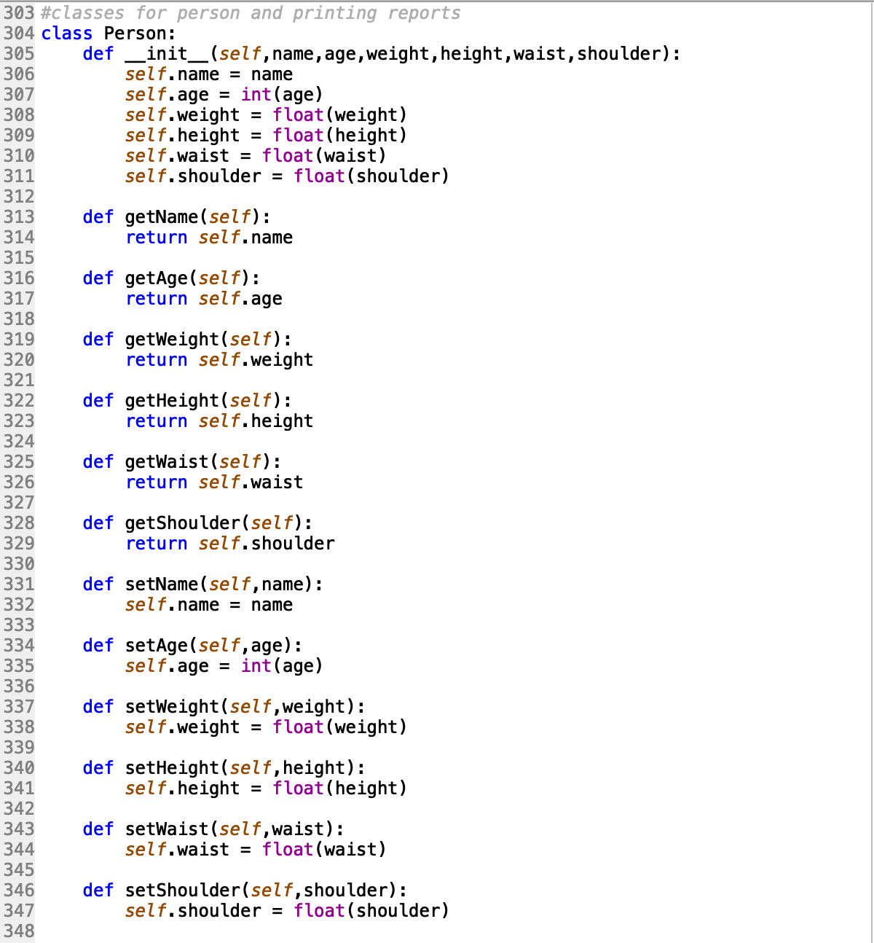
CODE- the library
PYFIT
Next, we come to the classes. This screenshot contains the Person class.
This class has the following attributes- name, age, weight, height, waist, shoulder.
Its methods are getters and setters for the above mentioned attributes.
An object of this class will be created when a user interacts with the system.

Slide 11
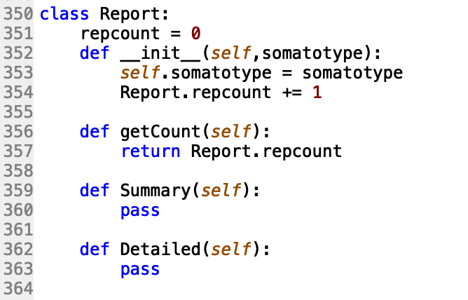
CODE- the library
PYFIT
This is the Report class.
This class takes ‘somatotype’ as an attribute to generate the respective reports.
Since the PYFIT system generates 2 types of reports, this class has methods called Summary and Detailed.
However, these methods do not do anything in the Report class as this is just a parent class. The Dietreport and Workoutreport classes inherit from this parent class, as shown in the next slide.
This class also counts the number of number of reports printed for the user.

Slide 12
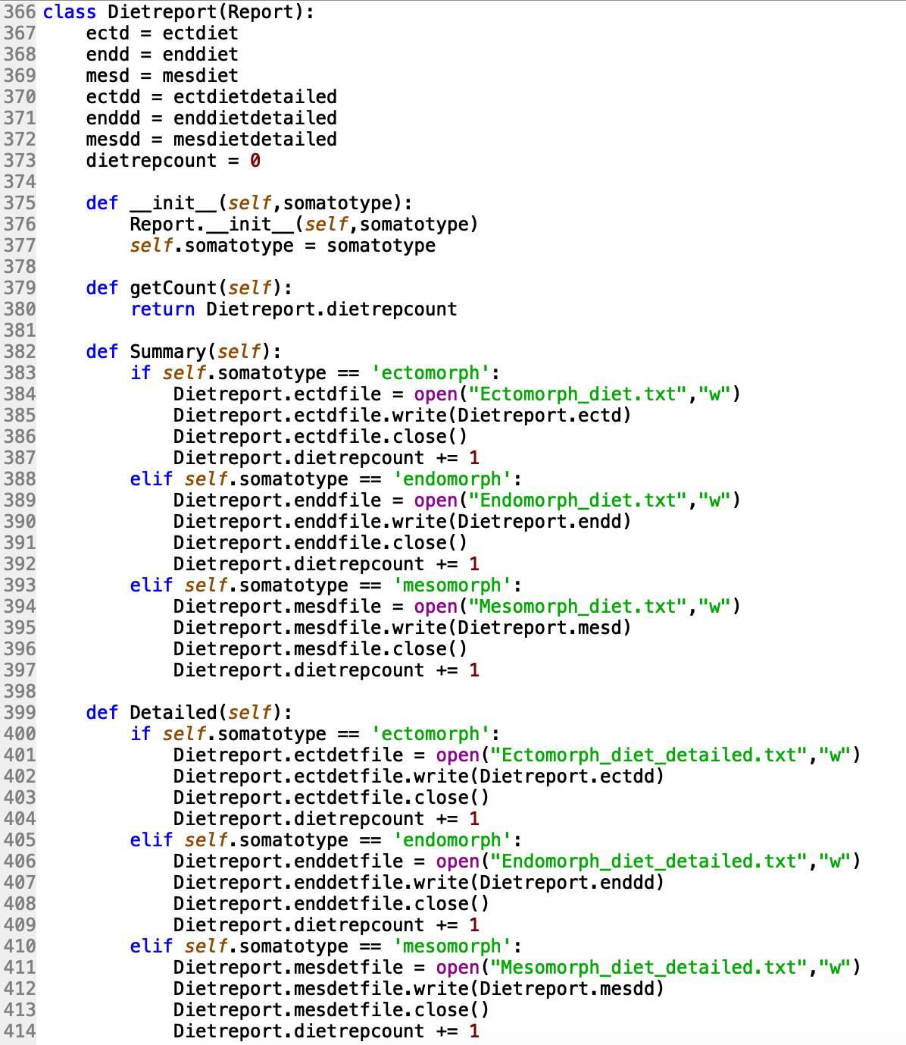
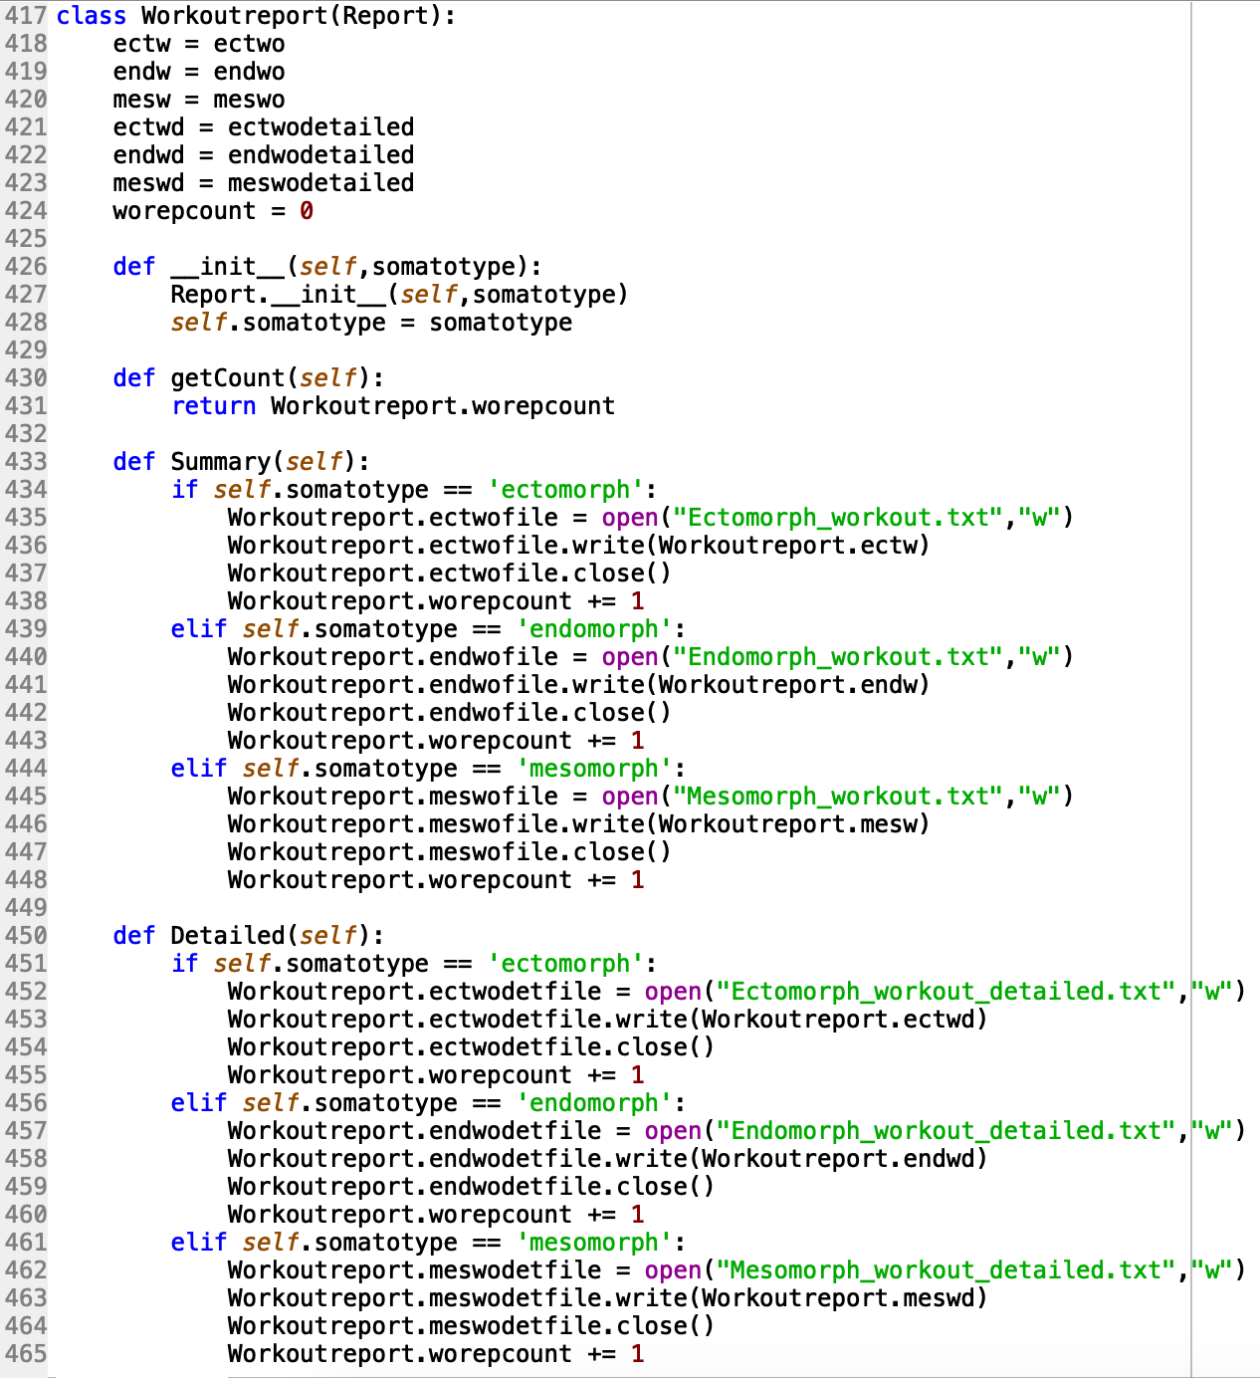
Below are screenshots of the Dietreport and Workoutreport classes. It can be seen that both classes exhibit inheritance and polymorphism from the Report class shown in the previous slide.
The function of these classes is to generate reports and export it to the users system based on his somatotype.
The ‘Summary' and ‘Detailed’ methods use if-else control statements to export the correct reports based on somatotype.

Slide 13
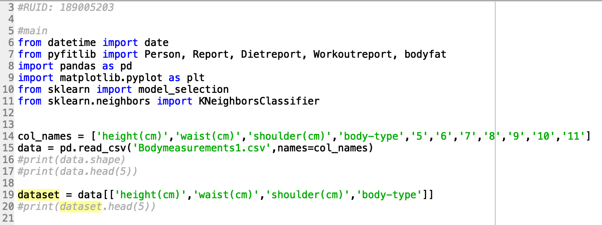
Code- Main program
PYFIT
In the main program, we import our custom pyfitlib library along with datetime, pandas, matplotlib and sklearn.
Below, we use pandas to read the CSV file containing the training data and it is stored as a dataframe(2 dimensional array).
As the original dataframe contained extra columns with NaN values, we narrowed it down to only the required columns and stored it as another dataframe called ‘dataset’.

Slide 14
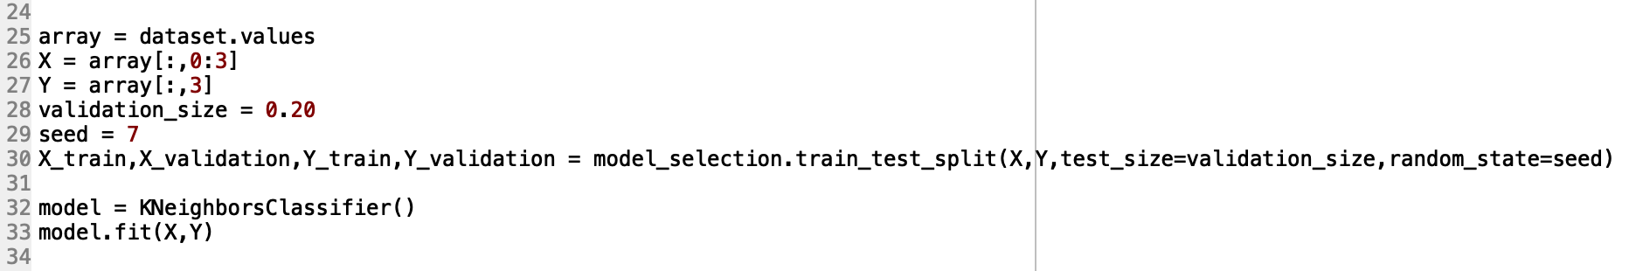
Code- Main program
PYFIT
Our dataset contains the following columns- height, weight, shoulder and body-type.
We split the values of the first three columns into array X and the last ‘body-type’ column into Y.
We use these two arrays to train the machine learning algorithm in order for it to predict future body type based on user inputs for height, weight and shoulder measurements (circumference).

Slide 15
KNN Algorithm
PYFIT
I chose K Nearest Neighbor for our software as it was the most suitable classification algorithm for this application.
KNN was most suitable as it is simple, efficient and compatible when there are more than 2 outcomes (3 in our case).
Initially, the Naive Bayes algorithm was considered but since it assumes independence among predictors, it was dropped. In our application, there is a relation between the 3 features- height, waist and shoulder.
Validation_size = 0.20 means that 80% of the data will be used to train the model and 20% for validation.

Slide 16
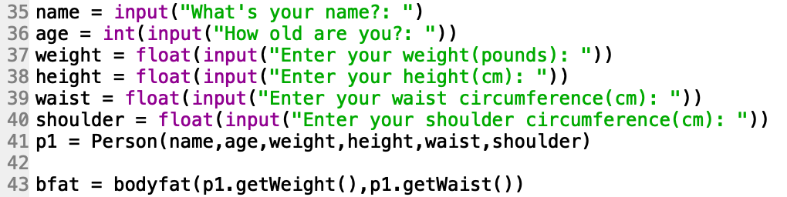
Code- Main program
PYFIT
Next, we accept the inputs from the user. Name is stored as a string, age as int and weight, height, waist and shoulder measurements are stored as float values (in centimeters).
Then an object of the person class is created with attributes as entered by the user.
We then use the bodyfat() function to determine the body fat percentage of the user.

Slide 17
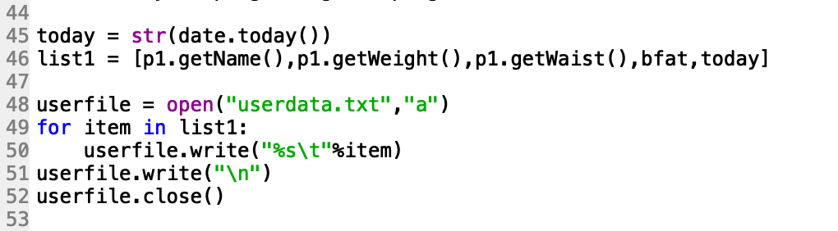
Code- Main program
PYFIT
Next, we save the name, weight, waist and body fat percentage of the user along with the current date into a text file which will later be used for progress tracking.
Yes, the user can get back to our software after a few weeks/months and keep track of his body stats!
The system also displays graphical data showing the progress of a particular user’s journey. This will be shown in the coming slides.

Slide 18
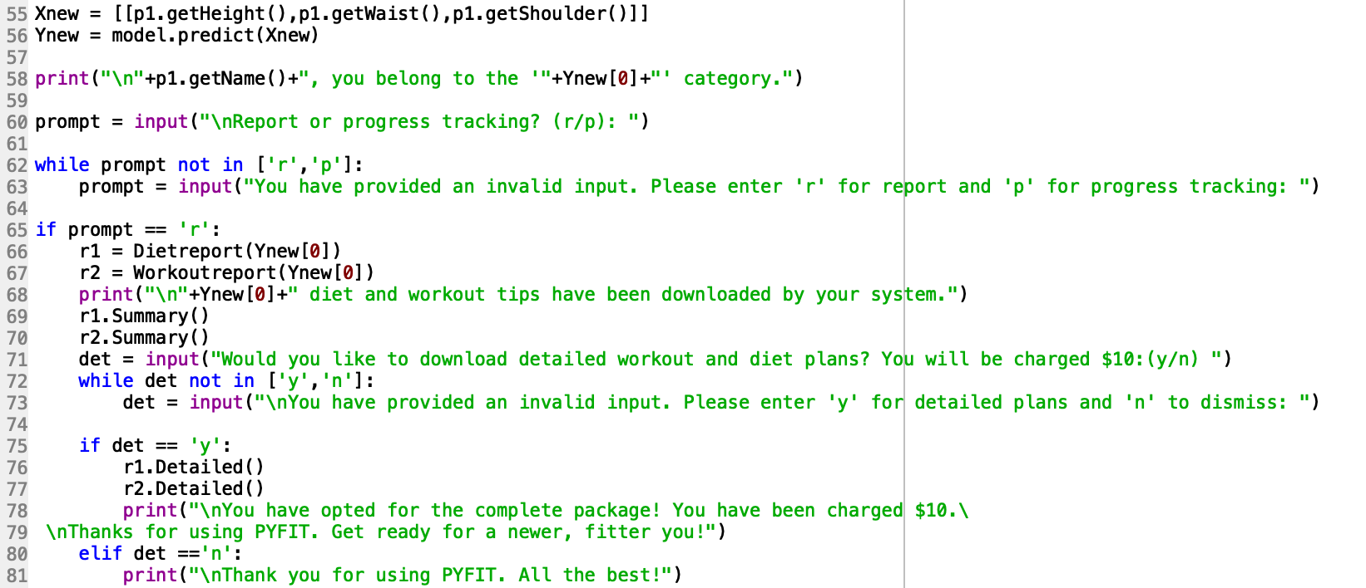
Code- Main program
PYFIT
We use the user inputs to determine body-type and display it to the user.
The user then gets prompted to pick between report or progress tracking. A first time user is better off choosing just the report option as the system would have recorded the user measurements only once.
A form of error handling is built-in using a while loop as the system will accept only two inputs: ‘r’ or ‘p’.

Slide 19
Code- Main program
PYFIT
Once the user inputs ‘r’, a summary diet and workout report is exported to the user’s system (in the folder containing the program).
Next, the user is asked if they would like to download fully detailed diet and workout plans for a one time charge of $10 (not really).
If the user inputs ‘y’ then detailed versions of the diet and workout plans are exported to the system.

Slide 20
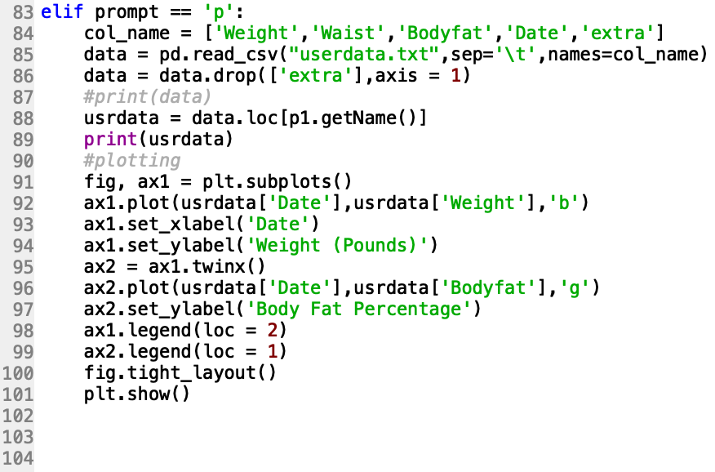
Code- Main program
PYFIT
If the user is not using the system for the first time and has already been inputting his details from the past few weeks, he can opt for the progress tracking option.
The system then displays a table containing the past data of the particular user along with a line graph displaying the weight and body fat percentage progress.

Slide 21
Readme- Running the program
Pyfit
The following libraries are required to run the program:
datetime
pandas
matplotlib
sklearn
pyfitlib.py custom library
The pyfitmain.py, pyfitlib.py and Bodymeasurements2.csv files have to be in the same folder.
The program creates a file called ‘userdata.txt’ when it runs, to store the users data.

Slide 22
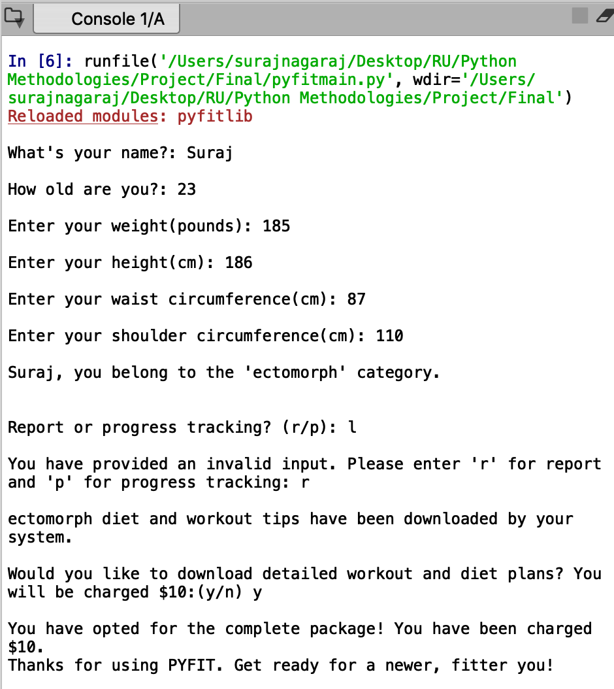
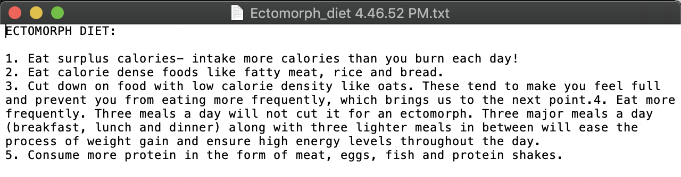
Running the program
PYFIT
To the right is what happens when I run the program for the first time and pick the ‘reporting’ option.
I have been classified into the ectomorph category and summary diet and workout plans have been exported to my system.
It can be seen how I input an ‘l’ when the program asked for ‘r’ or ‘p’ and it did not accept my invalid input.
Below is what the diet summary looks like.

Slide 23
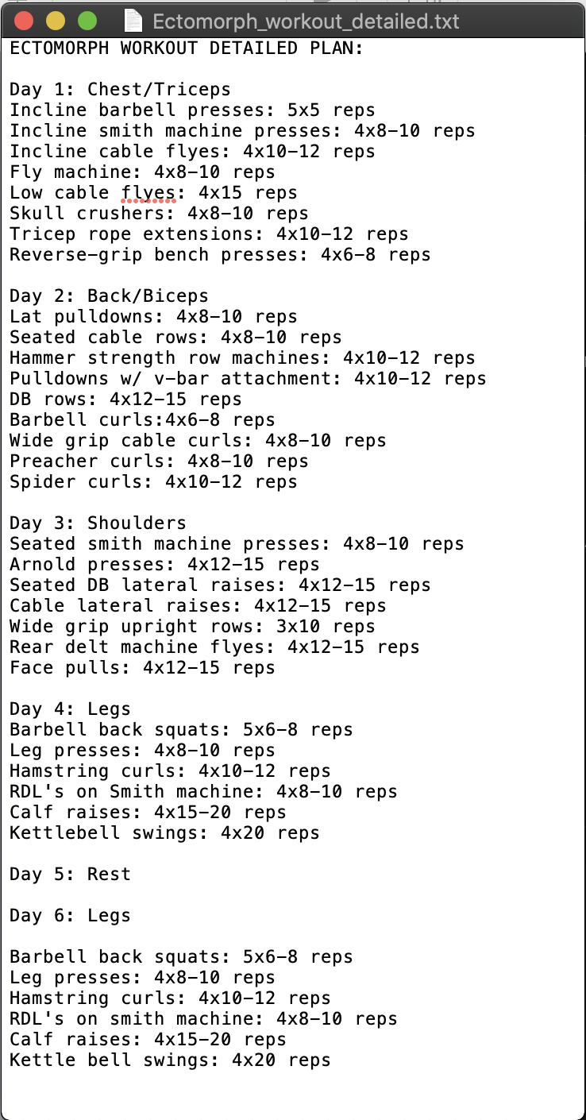
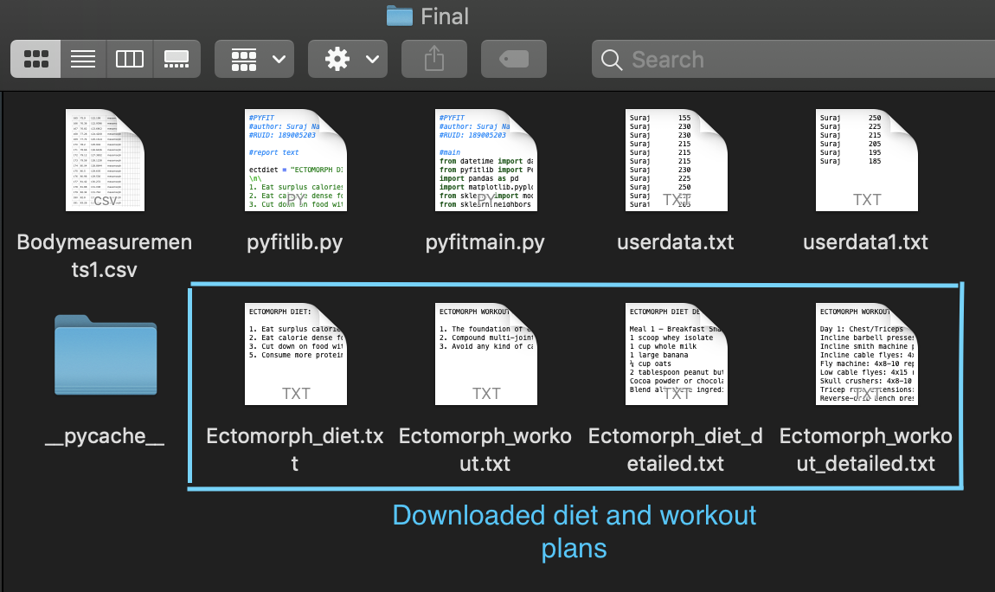
Running the program
PYFIT
The program then asks me if I would like to download a detailed version of the ectomorph reports for $10 and once I accept, the same is exported to my system.
To the right is what the detailed workout plan looks like. The diet plan is presented in a similar fashion. The image below shows the folder into which the .txt files are downloaded.

Slide 24
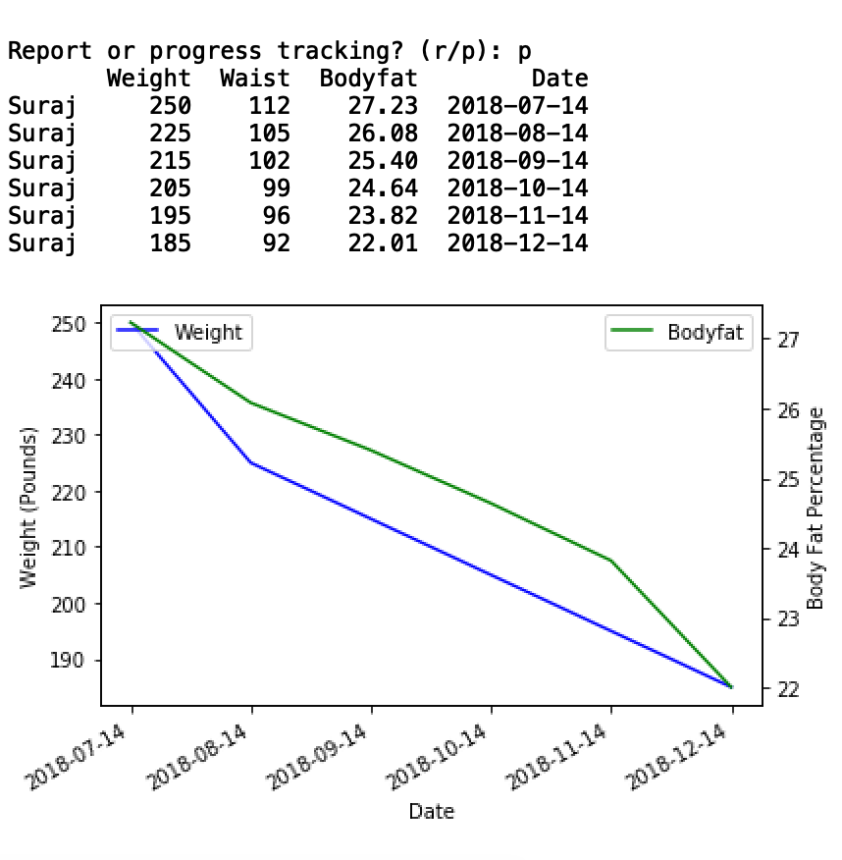
Running the program
PYFIT
When I pick ‘p’ for progress tracking, you get what is displayed to the right.
A table with all the past information regarding weight, waist size, body fat percentage and the date of the entry (of the particular user).
Below that is a graph that shows your progress since the first entry.
A particular user’s information is segregated from the rest of the entries based on the name.
*the data used for the progress tracking shown here has been created by me. When a user inputs his data to the system more often, the slope will be less steep.

Slide 25
Future scope
Pyfit
The Goal
PYFIT aims to simplify body tests and suggest the right nutrition plan tailor-made for an individual. This ensures accessibility of the above features to a wider audience, helping people who do not have the means to afford expensive body tests and/or a personal nutritionist.
Implement added functionality like body water analysis, detailed body mass index analysis, bone density test, etc.
Upgrade the progress tracking system to include more parameters like lean body mass, body water percentage and bone density.

Slide 26
THANK YOU
PyF

